Slide 1


Arab immigrants' acculturation in Hungary:
The role of competitive and cooperative relations
Mariem Jebali
PhD student, ELTE PPK PDI
Prof. Márta Fülöp, DSc
HUN-REN Institute of Cognitive Neuroscience
and Psychology, Research Centre of Natural Sciences

Slide 2
Introduction
There were approximately 12 000 immigrants of Arab ethnicity living in Hungary according to the latest Microcensus (2016). The number has been growing since significantly.
The migrant crisis (2015-2016) changed peoples’ attitudes all over Europe, yet the Hungarian case is considered special as the government actively intensified its anti-immigration campaign initiated early in January 2015, prior to the outbreak of the migration crisis, as Hungarian prime minister Viktor Orbán stated that: “We [Hungarians] do not want to see minorities of significant size with different cultural characteristics and backgrounds among us. We want to keep Hungary as Hungary” (Barna & Koltai, 2019).

Slide 3
Hungary serves as a transit country for various forms of migration, whether regular or irregular. Its geographical position, membership in the European Union (EU), and its relative prosperity make it an attractive destination for individuals from nearby nations, including those of Hungarian ethnicity. Being a member of the EU, certain borders of Hungary also constitute the external borders of the European Union.
Prior to the construction of the border fences along the Hungary-Serbia and Hungary-Croatia borders (2015), Hungary was one of the main entry points into the EU for migrants seeking to gain access to other Member States.
The Hungarian Government, in addition to the construction of border fences, has also enacted a series of legal amendments intended to reduce irregular migration through Hungary. Since their initial enactment in 2015, these measures have reduced asylum applications to Hungary, and decreased the number of irregular border crossings following their peak of 441,515 in 2015. Hungarian authorities apprehended around 122,000 illegal entrants in 2021.

Slide 4
According to the Pew Research Center, 72 % of Hungarians had unfavorable views of Muslims in 2016 compared to the EU median of 43 percent,[even though (or rather because) Hungary has practically no Muslim population.
Anti-immigration, anti-Arab and anti-Muslim sentiments, which hardly existed in Hungary before, are mainly based on the perceived cultural differences, and explained in the context of a war between cultures and civilizations.
Although the first generations of Arabs arriving in Hungary took place in the 1970s and 1980s, the research on this ethnic group in different domains is scarce and close to non-existent.
The first generations of Arab came to Hungary to study through a scholarship program that was agreed upon between the communist regimes that included numerous Arabic countries such as Iraq, Syria, and Yemen at the time.

Slide 5
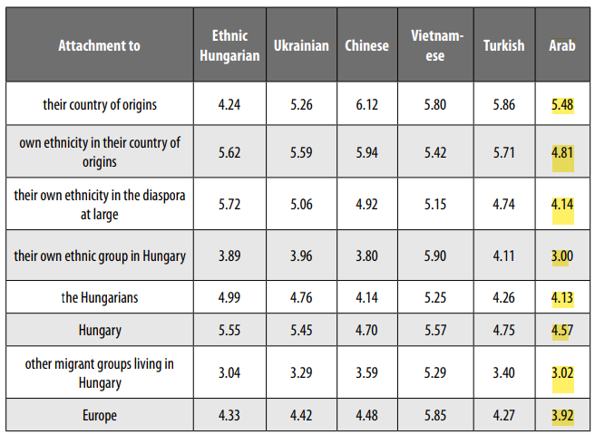
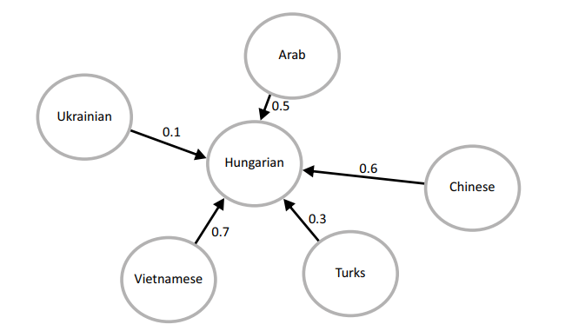


Arab Migrants in Hungary
(Csepeli & Örkény, 2021)
Levels of attachment in various migrant groups (averages on a 7-point scale
Arab’s attachment to Hungary (4.57) surpasses both the solidarity with the diaspora at large (4.14) and their own ethnic group in Hungary (3).
The social distance felt toward Hungarians, according to ethnicity of migrant group (measured
with the Bogardus scale)

Slide 6
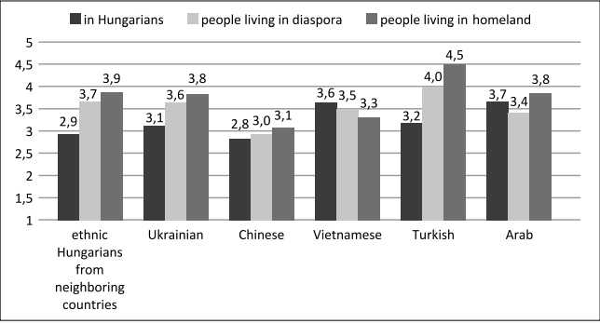
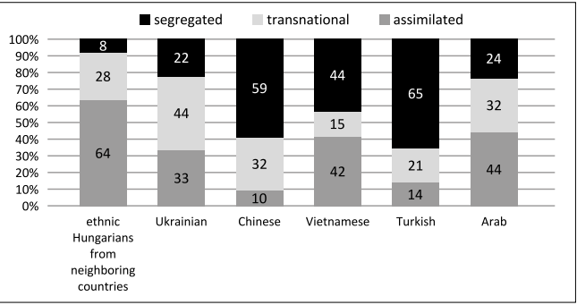
Arab Migrants in Hungary
(Csepeli & Örkény, 2021)
The level of trust expressed toward Hungarians, one’s own migrant group, and one’s fellow countrymen left behind, by ethnicity of migrant group (averages on a 5-point scale)
Arab, while most trusting toward fellow Arabs of their home country (3.8), have more faith in “Hungarians” (3.7) than in “Arabs living next door” (3.4).
The assimilationists: longer period of residency, attained the highest living standards.
32% of Arabs were identified as adopting the transnational strategy, these migrants were considering moving on to some other country and arranging their stay in Hungary accordingly.
Migration strategies by ethnicity of migrant groups

Slide 7
Participants
Nationalities:
Syrian (4)
Tunisian (4)
Palestanian (3)
Egyptian (3)
Yemeni (1)
Algerian (1)
Lebanese (1)
Jordanian (1)
18 Arab participants (12 men, 6 women)
Age range between 32-59 years old
Age distribution 18-35, 35-50, 50 above
Profession:
Marital status:
Period of residency in Hungary:
Businessman (6)
Business owner (4)
Restaurant manager (2)
IT engineer (2)
Tour guide/housewife
Retired
Nursery teacher
Doctor
Upholsterer
Souvenir shop worker
Married (13)
Divorced (2)
Single (2)
Widow (1)
Participants have been living in Hungary for at least 1 year, with a residency period ranging from 1 up to 36 years

Slide 8
Method
Conducted semi-structured interviews following a guideline developed Büki and Fülöp (2013) and extended to explore competitive and cooperative processes and their relationship with acculturation as well.
The questions covered a range of topics the immigrants’ motives to move to Hungary, and the areas in which they compete and cooperate with both individuals or groups from their own community as well as with members or groups of the Hungarian society. Questions also explored nature of the competitive processes in both contexts (constructive/destructive, the role of envy, trust, etc.) and targeted the acculturation strategy that characterizes the interviewee.
The interviews are recorded, transcribed verbatim and translated from Arabic to English.
Semi-structured interviews

Slide 9
Method
Associative group analysis is an unstructured method of research used to reconstruct people’s subjective images from the spontaneous distributions of their free associations. The method relies on the analysis of free associations to reconstruct the internal world and subjective meanings of people, arenas inaccessible by more direct methods. The basic unit of analysis is the stimulus word, or theme word, which evokes these associations and hence serves as a key unit in the perceptual representational system. (Linowes et. al.,2000).
The participants were given 1 minute to freely associate with the theme wors given: “Hungary”, Country of Origin”, “Competition” and “Cooperation”.
Later, each participant’s list of responses is weighted according to the readiness that the word came to mind (rank-order). The weighting of each response list was done empirically via differential stability of rank place using the test-retest method (Kelly 1985). Starting at the top of each participant’s word list, each word was ranked 6,5,4,3,3,3,3,2,2,1.
We later on divided the responses into separate categories.
Associative Group Analytic Technique (AGA) (Szalay & Deese, 1967)

Slide 10
Results:

Slide 11
Results:
“Hungary”
The responses from the Arab participants could be grouped into 8 categories (divided into Pull VS. Push). 7 categories belonged to the Pull factors with 71.69% of all associations. Only 3 categories were identified for the push Factors with only 28.31% of the associations
The most dominant category, Social advantages (19.88%), followed by Home/Social Inclusion(17.17%) of the associations.
Therefore, pull factors such as the social advantages, social inclusion, positive attributes, and safety mostly attracts the participants to remain in Hungary compared to the negative emotions (14.16%), social exclusion (5.72%),and weather (4.82%) that can deter Arabs from remaining in Hungary.
Table 1 . Participants' categories of associations to Hungary

Slide 12
Results:
“Country of Origin”
The responses from the Arab participants could be grouped into 9 categories (divided into Pull VS. Push). 5 categories belonged to the Pull factors with the majority 92.75% of all associations. The remaining 7.25% is divided between the 4 Push categories .
The three dominant categories, Positive attributes/emotions (30.05%), Home (20.21%), Family and connections (20.73%) covered 70.99 % of the associations.
In case of country of Origin, the pull factors also dominates the evocation of the participants and accentuating their sense of belonging and loyalty to their home country.
Table 2 . Participants' categories of associations to Country of Origin

Slide 13
Hungary Vs. “Country of Origin”
For both Hungary and the country of Origin, the participants expressed far more pull factors than push ones, this is indicates their ongoing sense of belonging to their countries, and their attraction to remain in Hungary.
However, the participants evoked far more pull factors towards Hungary (28.31%), with a special focus on their social exclusion and environmental challenges, than towards their own countries (7.25%), focusing more on the political and economical challenges,
Our participants perceive both Hungary and their own countries in a positive light but their answers suggest that they do not believe Hungarians are welcoming towards Arabs and they are not feeling socially included within the Hungarian society.

Slide 14
Results:
“Competition”
The most dominant category, motivation, covered more than a third (37.34%) of the associations followed by winning (17.53%).
The subjective meaning of competition is overwhelming ly positive, only 3.90% of the associations have negative connotation.
According to the categories, Arabs consider competition to be a motivating process, requiring hard work leadiung to self improvement and with the main goal of winning.
Their words with the highest weight refer mainly to challenge (6.17%), motivation (4.55%), success (5.52%), wining (3.90%). This essentially paint competition as a drive for success and constant improvement
Table 3 . Participants' categories of associations to Competition

Slide 15
Results:
“Cooperation”
The most dominant categories are, Support and Help (35.08%) and Social relationships (30.16) that covered more than half of the associations.
Compared to competition, our participants evoked less associations when discussing cooperation.
Both competition and cooperation were perceived as motivation towards success and goal attainment.
Participants believe that competition and cooperation can be used conjointly to achieve success and reach their goals.
Table 4 . Participants' categories of associations to Cooperation

Slide 16
In-Group Competition
“…after I came here to study, my uncle sent his son to study in Germany, he finished medical school there and now he is a successful doctor and he still lives there, growing up we were always compared to each other as we were closest in age, I was 3 years older than him, to be honest I was jealous of him as he managed to finish university and pursue his dream of becoming a doctor, I always felt that I disappointed my father when I quit school, even though it was not my dream to become a doctor…” (Male, 53 years old)
Out-Group Competition
“I would say that the Hungarian I compete with since I came here was my brother in law, or my wife’s sister’s husband, I always felt that I was compared to him in every aspect, my in laws of course preferred him more, not only because he was Hungarians and thus easier to accept, but also because he had a stable job as an accountant so I always felt that I was being pitted against him and I always proved to be a failure when compared to him. As you know Arab men, we are the providers of the house we need to be able to take care of our families financially, so me staying home when I first came here made me feel emasculated and created a lot of tension with my in laws as well as her family which led to our separation. I believe even until today I am being compared to him and the same goes for my wife, as her sister married a much successful and acceptable man so she just felt bad and pushed me away because of that”. (Male,37 years old)

Slide 17
In-Group Cooperation
“When I first moved her to study, my father supported me financially, paying for my university fees, my rent and everything else… I would have never moved here to Hungary if it was not for my family and my father paying for everything, even the idea of studying in Hungary was my father’s, and of course if it was not for my family’s moral support and encouragement to have a degree and pursue my dreams, I would have never been able to reach my goals and be where I am today.” (Male, 53 years old)
Out-Group Cooperation
“With my first wife’s family, I was still a young man looking to plant his roots and establish a successful future, sol I did receive a lot of support from my wife who was my point of reference in the country, and her father who helped me with finding my first job in the country, I did not speak the language really well at the time, so finding a job was really not that easy, however my father in law spoke with a friend of his who had small trading company who was open to hire me with a good and fair salary. “ (Male, 53 years old)

Slide 18
Summary
Hungary Vs Country of origin
Competition
The participants associated both Hungary and their country of origin in similar lights, in both cases the pull factors outweighed the push factors. However, the push factors for Hungary 28.31% are greater than those for all the participants home country (7.25%).
Our participants, with longer residence period in Hungary, refers to both Hungary and their home country as “Home” and expressed their love and attachment to bot h countries suggesting that they managed to integrate into the Hungarian society and while maintaining their culture of origin.
The overall perception of Competition by all of our participants is positive.
This hard work and strive for success through competition as well as cooperation is translated in the participants integration efforts along their personal life, career aspirations, and everyday life activities in Hungary.
Cooperation
The participants perceive cooperation as a selfless act of support that, as is the case of competition, leads to success and a win-win between individuals.
However, when compared to their home country, they believe cooperation in Hungary is not as common or as often.

Slide 19
References
Büki, L. N. (2013). The role of competition in the integration of immigrants to the host society
Csepeli, G., & Örkény, A. (2021). Nation and Migration: How Citizens in Europe Are Coping with Xenophobia. Central European University Press. https://doi.org/10.7829/9789633863664
Szalay, L. B., Carroll, J. F. X., & Tims, F. (1993). Rediscovering free associations for use in psychotherapy. Psychotherapy: Theory, Research, Practice, Training, 30(2), 344–356.
Vidra, Z. (2018). Dominant Counter-Narratives to Islamophobia – Hungary (No. 12).

Slide 20

Thank you
Q&A
Mail:
mariem@student.elte.hu

