Slide 1
Exploring the Migration Process of Iranian Asylum Seekers in Europe: A Case of Serbia and Bosnia and Herzegovina
Presented By Faranak Gholampour
PhD Candidate in Sociology, Faculty of Social sciences, Doctoral school of Sociology, ELTE University, Budapest, Hungary, faranak.gholampour@gmail.com
Supervisor: Dr. Borbála Simonovits
Sociologist (PhD), Institute of Intercultural Psychology and Education, ELTE University, Budapest, Hungary, simonovits.borbala@ppk.elte.hu

Slide 2
Structure of the presentation
Introduction
Brief definitions, Statistics
Theoretical Background
Theories, The main research questions
Methodology
Participants, Procedure and data analysis
Limitations
Results
Limitations of the research
The findings

Slide 3
Irregular migration: Who are asylum seekers?

Slide 4
The main transit countries in Europe?
(Greider, 2017)

Slide 5
Theoretical background
Motivation of migration
Migration decision making: Rational choice theory
Social capital theory and network theory
Push and pull factors

Slide 6
The main research questions:
Q1. What is the motivation of Iranian asylum seekers for leaving Iran?
Q2. What are the most difficulties Iranian asylum seekers face in Europe?

Slide 7
Methodology
Research Design
Qualitative, semi-structured interview
Sid refugee camp in Serbia/ Sedra refugee camp in B&H
Purposive and snowball sampling
Translation from Persian to English/ Coding

Slide 8
Participants’ Socio-demographic characteristics:
 | N Range M
Participant’s age Sex Male Female Ethnicity Persian | 17 19-46 36.00 11 6 10
Arabic | 1
Kurdish | 5
Baloch Marital status | 1
Married | 12
Widow(er) | 1
Single Divorced | 3 1
Education
No schooling completed | 1
Some high school, no diploma | 4
Diploma or the equivalent | 9
Bachelor’s degree | 2
Master’s degree | 1

Slide 9
Results: Motivation of migration

Slide 10
Lack of job security (5 interviewees)
Although I had 130 contractors who were working under my supervision and I was checking their work, they retrenched me [...] After that, I was seeking a job for about 2 years and I became tired. My main reason for leaving Iran was the lack of job security. [...] I studied a lot, and I was educated, why should I lose my job in Iran? This really annoyed and irritated me. (No. 4, 40 years old, male)

Slide 11
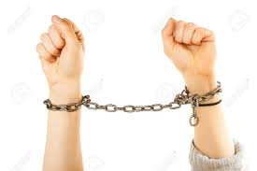
Lack of social freedom (4 interviewees)
My son called me and said the police had arrested him. They arrested my son because he was playing water shooting with other boys and girls. Police slapped him in the face at the police station and because it was Ramadan, he was flogged one time by a whip on his back and they took a written commitment from him. [...] That was just one thing, we did not have freedom. We were involved with everyday problems, and were told what to do or not, or will be arrested for no reason. (No. 1, 46 years old, female)

Slide 12
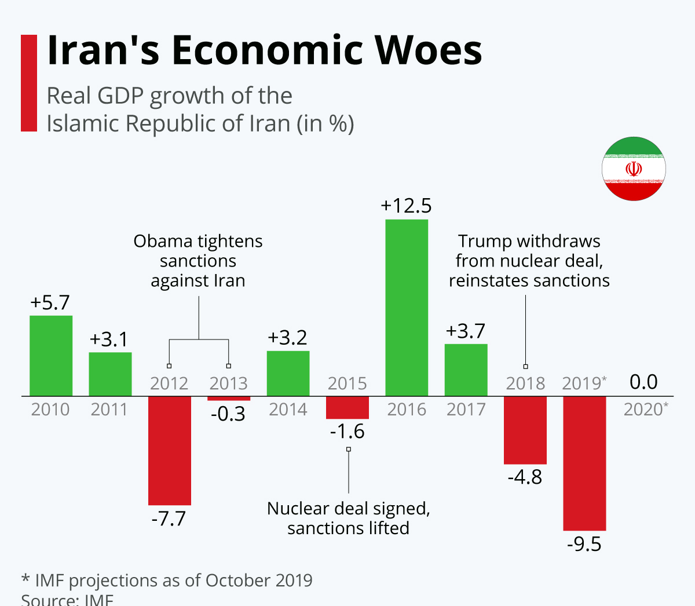
Economic issues (4 interviewees)
You know that the economic situation in Iran is a disaster. My husband and I both were working, and our life was not bad, it was good, but we were going to get into financial pro- blems and could not respond to our children’s needs. (No. 1, 46 years old, female)

Slide 13
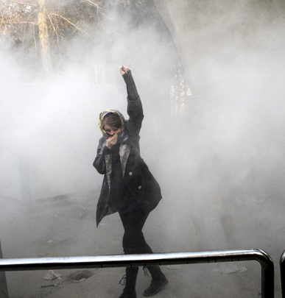
Political reasons (3 interviewees)
Someone, maybe a neighbor, from the village ratted me out and called the Guard Corps. [...] We could not go back home because they execute anyone who supports Peshmergas. We stayed at my sister’s place for the night, but the Guard Corps were following us and wanted to catch me. (No. 8, 35 years old, male)

Slide 14
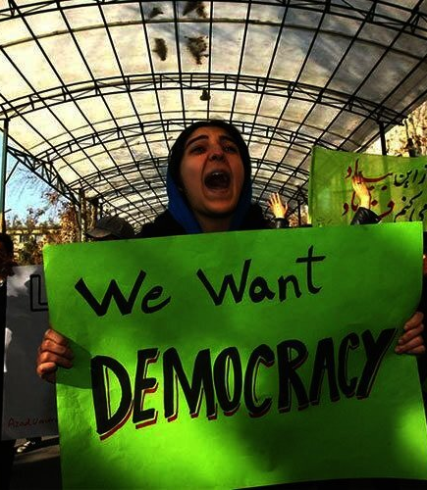
Prefer not to say (3 interviewees)
I was forced to leave Iran otherwise I would never have left Iran because my job position was good, my income was good and I lived in a good place, everything was good, and I was com- fortable. [...] Immigration was nothing but a hassle for us. I cannot tell you my main reason for leaving Iran. I had to leave Iran but there are economic issues, political issues, lack of democracy in Iran, you should see what is not an issue in Iran. (No. 6, 42 years old, male)

Slide 15
Family issues in Iran (2 interviewees)
We had a lot of problems with my husband’s family. [...] My son also had a lot of problems too. Someone committed murder and put all the faults on my son. [...] My son was acquitted by the court, but he was annoyed every day because of something he did not do. (No. 2, 40 years old, female)

Slide 16
Religious persecution (1 interviewee)
They sent me to the jail, accused of disturbing the public opinion and country officials by correspondence and writing letters about Sufi’s problems. [...] I was accused of blasphemy too because I did not have religious education in Qom Seminary, and I shaved my beard once in the past. So, I was sentenced to 5 years in prison for insulting the sanctities of Islam and I was flogged 75 times by whip for writing letters to country officials and I also was sentenced to be exiled to Shahre Babak in Kerman province for 10 years. (No. 3, 40 years old, male)

Slide 17
Immigrants’ social networks
I talked to my aunt when she was in Serbia, she left Iran before us. She said camps and everything is fine in Serbia. My aunt felt fine when she was in Serbia, but it was not okay when I was in Serbia myself. (No. 7, 19 years old, male)

Slide 18
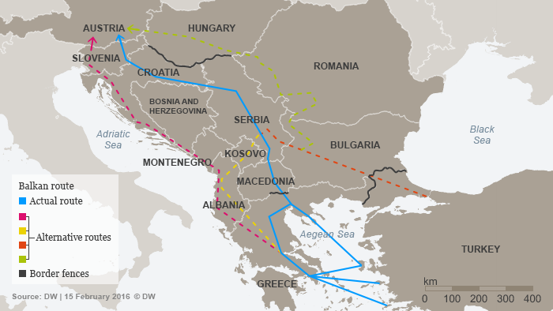
The route from Iran to Europe
Asylum seekers took two main routes from departure:
The land border with Turkey (7 interviewees)
Flew from Iran to Turkey or Serbia (10 interviewees)
(DW, 2016)

Slide 19
Experiences/difficulties on the way
Problem with Croatian policemen (7 interviewees):
We walked from Sid city to Croatia. [...] We crossed Croatia and were about 50 km to Slovenia when the Croatian police caught us in the forest. They did not do anything to our children. But we were about seven adults. We were all beaten by them. They broke our cell phones. Men were beaten in front of their women and children. We were put in a car and dropped off near Sid city again. (No. 10, 45 years old, male)
Problem with the smugglers (All interviewees):
In Greece, we paid 1,000 EUR each person to a smuggler to take us from Greece to Serbia. When we arrived in Macedonia, I was a hostage in the smuggler’s home for about two months. I was harassed a lot by him. My 1.5-year-old daughter was beaten by the smuggler. He took money from me but did not take me to Serbia. One day I decided to move to Serbia myself. I gave clothes, shoes, food, money, and whatever I had to Macedonian people just to show me the route to Serbia. (No. 14, 24 years old, female)

Slide 20
Living conditions in the country of residence 1. Adaptation
Participation in language classes
Using some Serbian or Bosnian words while interacting with locals
Local friends
Like to be in touch with both locals and Iranian communities
Like their national identity
No difficulties in adjusting to the weather

Slide 21
2. Camp situation
Camp conditions
Health, medical, and counseling services
Dentistry is not good here at all. Because we do not pay money and it is free. My toothache has reached the nerve and I have nerve pain now. I went to the camp dental clinic and they just wanted to extract my tooth. I asked them for a root canal treatment, and they said we only pull out the tooth. (No. 1, 46 years old, female)

Slide 22
3. Discrimination (2 interviewees)
I do not know what kind of individuals these local people have encountered with before, but I feel insulted in the shops when someone stands over me and stares at me while I am shop- ping. Maybe something was really stolen from them, I do not know. [...] In Serbia, their eyes are on you all the time as if you want to steal something. Even if you say something is expensive, they will say we do not have this product at all or we do not sell it at all. (No. 11, 38 years old, male)

Slide 23
The limitation of the study
Highly influenced by COVID-19 pandemic
The sample size
Limit the generalizability of the result

Slide 24
References
DW. (2016). Slovenia, Serbia and Croatia move to close migrant route. Retrieved from https://www.dw.com/en/slovenia-serbia-and-croatia-move-to-close-migrant-route/a-19102872
Greider, A. (2017). Outsourcing Migration Management: The Role of the Western Balkans in the European Refugee Crisis. Retrieved from https://www.migrationpolicy.org/article/outsourcing-migration-management-western-balkans-europes-refugee-crisis

